Slide 1

Study Report
Fu Kangwei
2019.10.21

Slide 2
About L2CAP
L2CAP: Logical Link Control and Adaptation Layer Protocol.
Function:
Protocol multiplexing capability.
Segmentation and reassembly operation.
Provide connectionoriented and connectionless data services to upper layer protocols.
Per-channel flow control and retransmission.
L2CAP channel: Multiplex over one or more logical links.

Slide 3
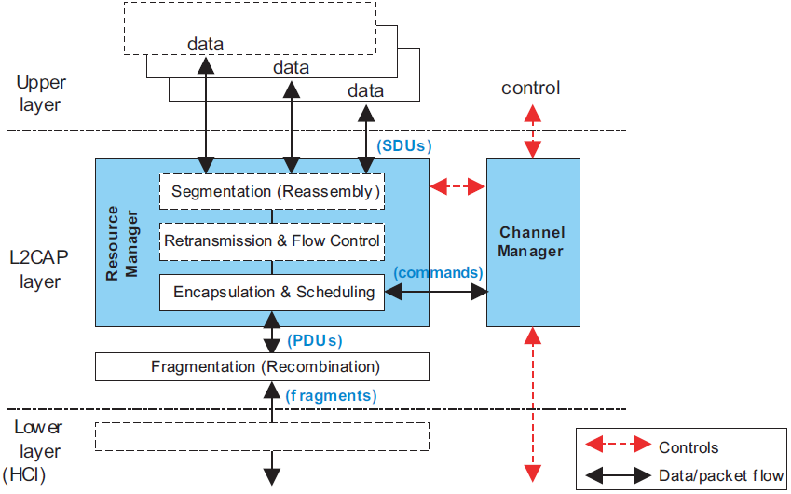
L2CAP Architectural

Slide 4
L2CAP Architectural
Channel Manager: Provide the control plane functionality.
Retransmission & Flow Control: Provide per-channel flow control and error recovery using packet retransmission.
Resource Manager: Provide a frame relay service to Channel Manager, Retransmission & Flow Control block.
SDU: L2CAP Service Data Units.
PDU: Packet Data Unit.

Slide 5
Channel Identifier (CID)
CID: Each one of the endpoints of an L2CAP channel.
0x0000: Never be used.
0x0001 to 0x003F: For specific L2CAP functions.
0x0002: All incoming and outgoing connectionless data traffic.
0x0005: L2CAP LE Signaling channel.
Configuration parameters.
Security.
Ability to change parameters.
Fixed channel characteristics
Fixed channels are available as soon as the ACL-U or LE-U logical link is set up.

Slide 6
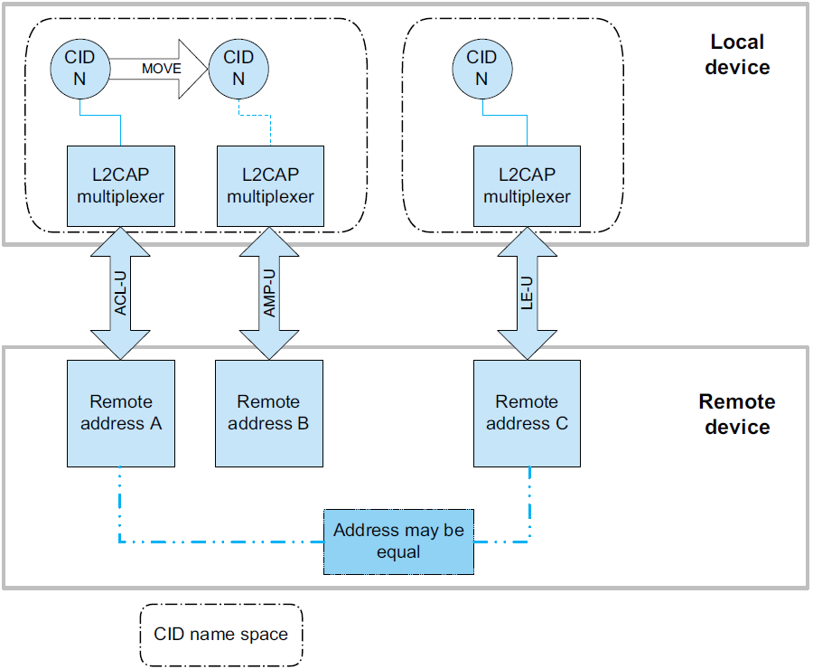
Channel Identifier (CID)
Dynamically allocated CID:
Relative to a particular logical link.
A device can assign CIDs independently from other devices.

Slide 7
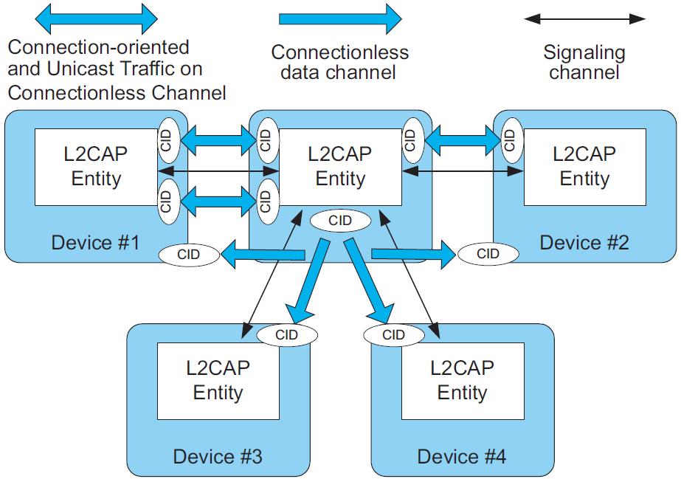
Operation Between Devices

Slide 8
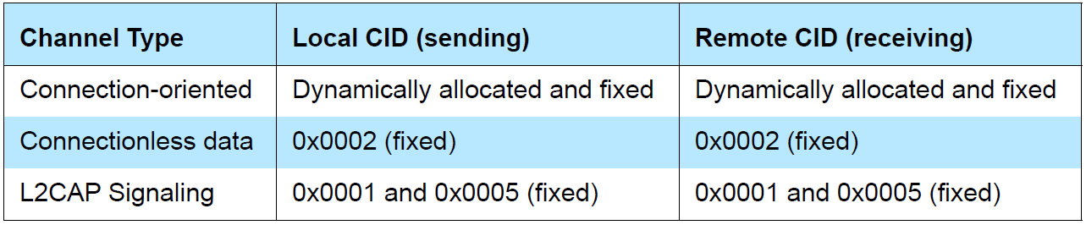
Operation Between Devices
Connectionoriented data channel: CID and the combined logical link identify each endpoint of the channel.
Broadcast transmission: Connectionless channel may be used to transmit data to all active slaves, using Active Broadcast.
Unicast transmission: Connectionless channel may be used in either direction between a master and a slave.
Types of Channel Identifiers

Slide 9
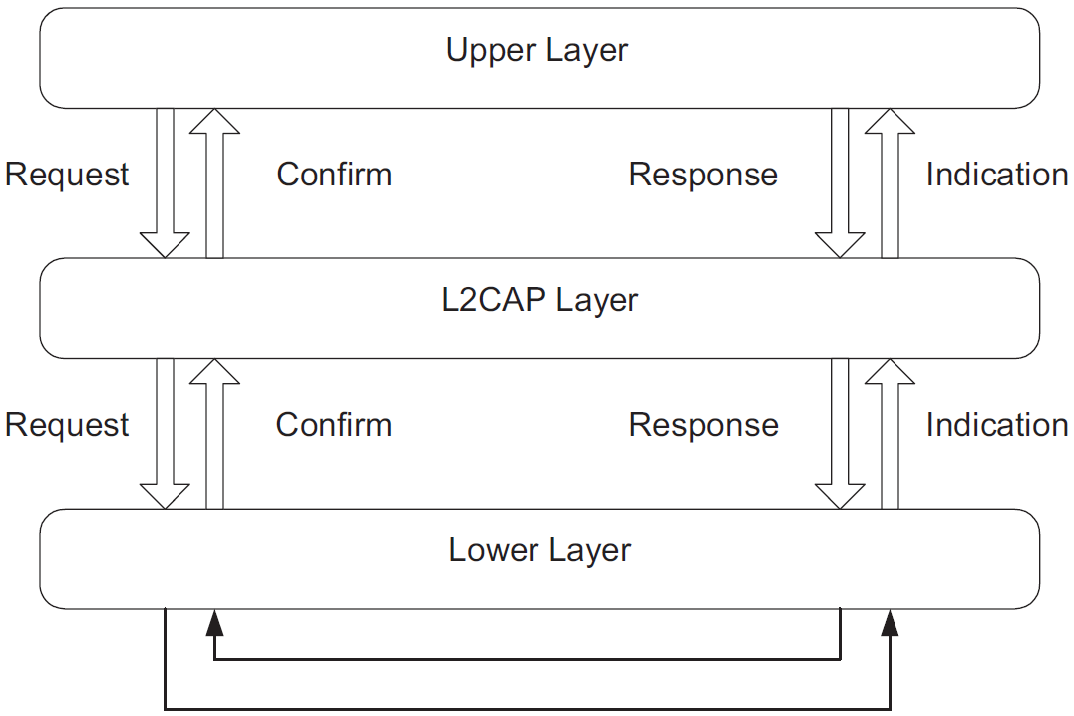
Operation Between Layers
L2CAP transfers data between upper layer protocols and lower layer protocol.

Slide 10
Operation Between Layers
Basic L2CAP Mode
Flow Control Mode
Retransmission Mode
Enhanced Retransmission Mode
Streaming Mode
LE Credit Based Flow Control Mode
L2CAP Channel
Operation modes

Slide 11
Operation Between Layers
Basic L2CAP: The default mode. Only for L2CAP channels operating over ACL-U logical links.
Flow Control: No retransmissions take place, but missing PDUs are detected and can be reported as lost.
Retransmission: A timer is used to ensure that all PDUs are delivered to the peer, by retransmitting PDUs as needed.

Slide 12
Operation Between Layers
Enhanced Retransmission: All reliable channels created over AMP-U and ACL-U logical links.
Streaming: Stream applications created over AMP-U and ACL-U logical links.
LE Credit Based Flow Control: The only mode used for LE L2CAP connection oriented channels.

Slide 13
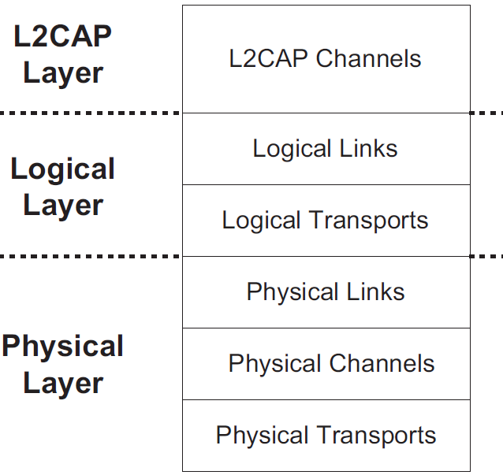
Mapping Channels To Logical Links

Slide 14
Mapping Channels To Logical Links
L2CAP maps channels to Controller logical links, which in turn run over Controller physical links.
All logical links going between a local Controller and remote Controller run over a single physical link.
There is one LE-U logical link per LE physical link.
All channels going over an LE physical link shall be treated as best effort.

Slide 15
Data Packet Format
Channels may be connection-oriented or connectionless.
All channels with dynamically assigned CIDs are connection-oriented.
All L2CAP layer packet fields shall use Little Endian byte order, except the information payload field.
L2CAP connectionless channel
L2CAP signaling channels
Connectionless
CID 0x0001
CID 0x0005

Slide 16
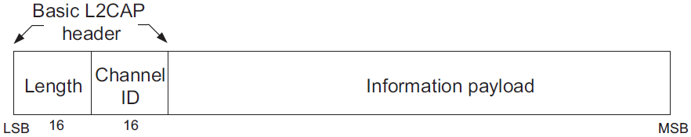
Basic information frame: B-frame
Basic L2CAP mode.
Connectionoriented channel.
B-frame
Length: Indicate the size of information payload in octets, excluding the length of the L2CAP header.
Channel ID (CID): Identify the destination channel endpoint of the packet.
Information payload: Contain the payload received from the upper layer protocol, or delivered to the upper layer protocol.

Slide 17
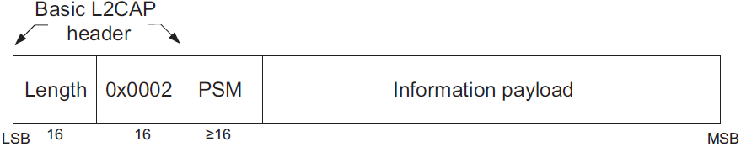
Basic information frame: G-frame
Connectionless data channel.
G-frame
Length: Indicate the size of information payload plus the PSM field in octets.
Channel ID: 0x0002.
Protocol/Service Multiplexer (PSM): PSM field.
Information payload
Payload information to be distributed to all slaves in the piconet for broadcast connectionless traffic.
Data sent to a specific remote device via the L2CAP connectionless channel.

Slide 18
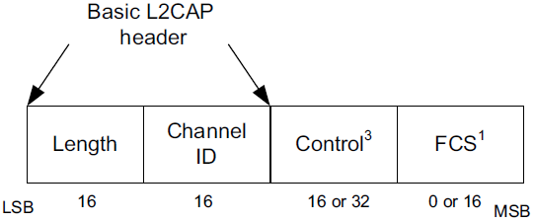
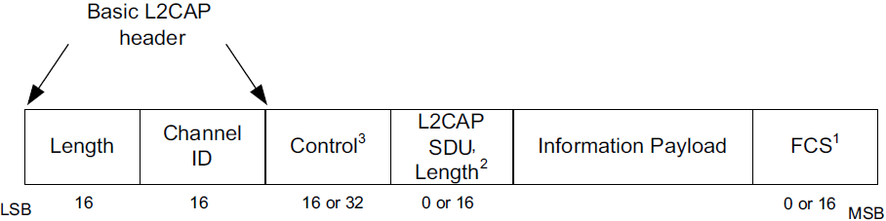
Basic information frame: S- & I-frame
Flow control
Retransmissions
Streaming
S-frame
Support
I-frame
Information frame (I-frame): Used for information transfer between L2CAP entities.
Supervisory frame (S-frame): Used to acknowledge I-frames and request retransmission of I-frames.

Slide 19
Basic information frame: S- & I-frame
Length: length of the entire L2CAP PDU in octets, excluding Length and CID field.
Channel ID: Channel Identification (CID).
Retransmission mode
Flow Control mode
Standard Control Field
Enhanced Control Field
Extended Control Field
Control field
Enhanced Retransmission mode
Streaming mode
Enhanced Retransmission mode
Streaming mode
Note: I- & S- frames types are distinguished by the least significant bit in the Control Field!

Slide 20
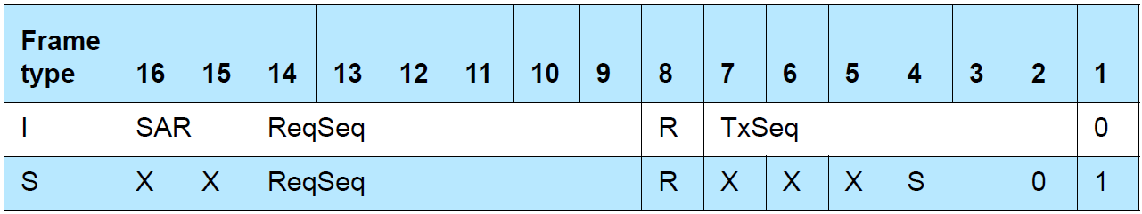
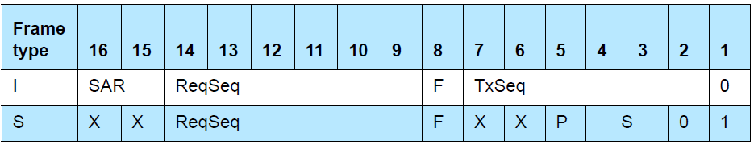
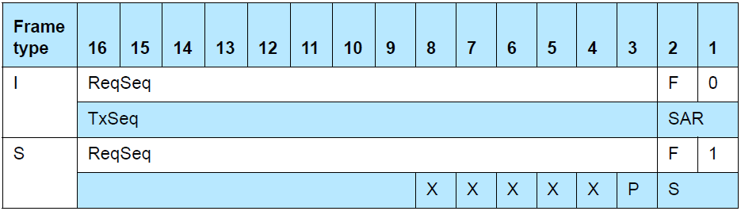
Control Field
Standard Control Field formats
Enhanced Control Field formats
Extended Control Field formats

Slide 21
I-frame
I-frames:
TxSeq (Send sequence number), ReqSeq (Receive sequence number).
I-frame with Standard Control field has R-bit that affects whether I-frames are retransmitted.
I-frame with Enhanced Control Field or an Extended Control Field has F-bit that is used in Poll/Final bit functions.
SAR is used for segmentation and reassembly control.
L2CAP SDU Length specifies the length of an SDU.

Slide 22
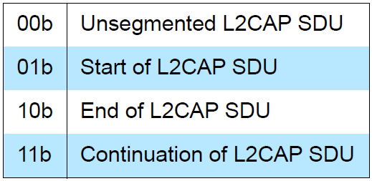
I-frame
Segmentation And Reassembly (SAR):
SAR defines whether an L2CAP SDU is segmented.
For segmented SDUs, SAR defines which part of an SDU is in this I-frame.
I-frame with SAR=Start of L2CAP SDU specifies the number of information octets in the total L2CAP SDU.
SAR control element format

Slide 23
S-frame
S-frames:
ReqSeq sequence number.
S-frame with Standard Control Field has R-bit that affects whether I-frames are retransmitted.
S-frame with Enhanced Control Field or Extended Control Field has P-bit and F-bit and does not have R-bit.
RR (Receiver Ready)
REJ (Reject)
RNR (Receiver Not Ready)
SREJ (Selective Reject)
Defined types
of S-frames

Slide 24
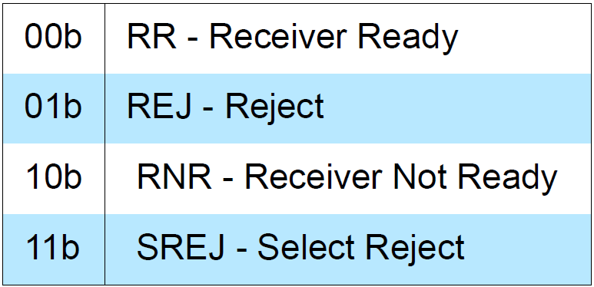
S-frame
S-bits mark the type of S-frame.
P-bit: set to 1 to solicit a response from the receiver.
F-bit: set to 1 in response to S-frame with the P-bit set to 1.

Slide 25
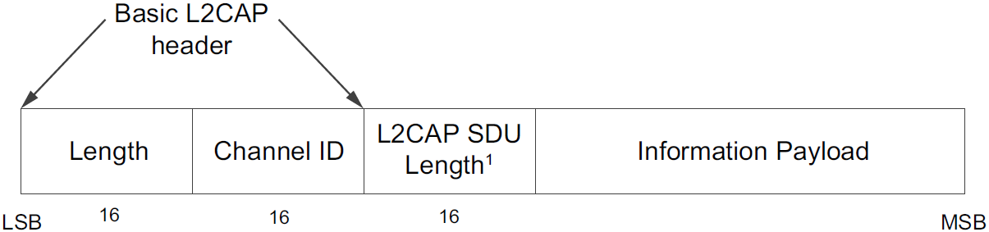
LE-frame
Support LE Credit Based Flow Control Mode.
Connection-oriented channel.
Length: Octet lengths of L2CAP SDU Length and Information Payload.
Channel ID (CID): Destination channel endpoint of the packet.
L2CAP SDU Length: Total number of octets in the SDU.

Slide 26
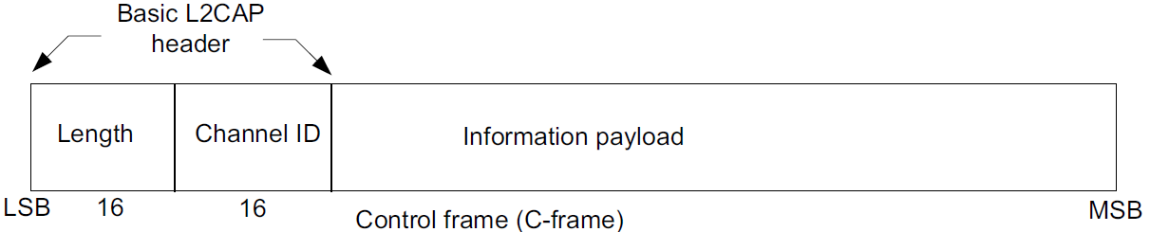
Signaling Packet Formats
Signaling channel for managing channels over ACL-U logical links use CID 0x0001.
Signaling channel for managing channels over LE-U logical links use CID 0x0005.
Multiple commands may be sent in a single C-frame over CID 0x0001.
Only one command per C-frame shall be sent over CID 0x0005.

Slide 27
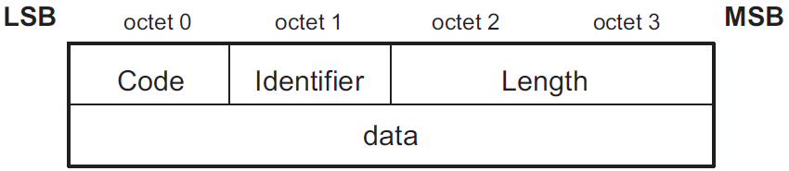
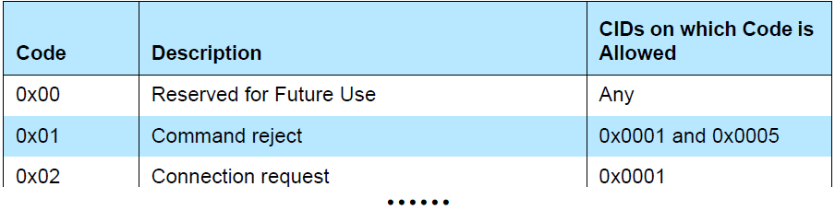
Command format
Code: type of command.
Identifier: match responses with requests.
Length: size in octets of the data of the command only.
data: variable in length.

Slide 28
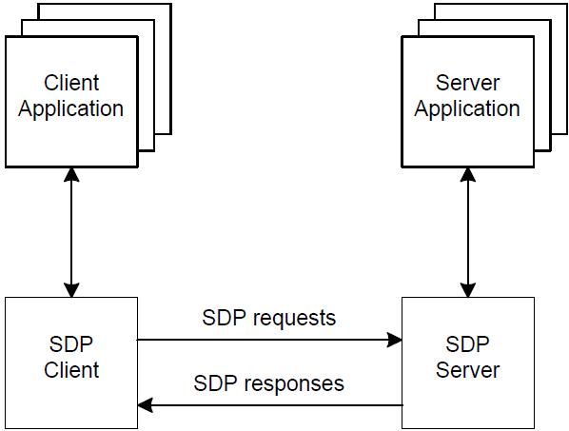
Service Discovery Protocol (SDP)
Discover which services are available.
Determine the characteristics of those available services.
The set of services that are available changes dynamically based on the RF proximity of devices in motion.
SDP Client-Server Interaction

Slide 29
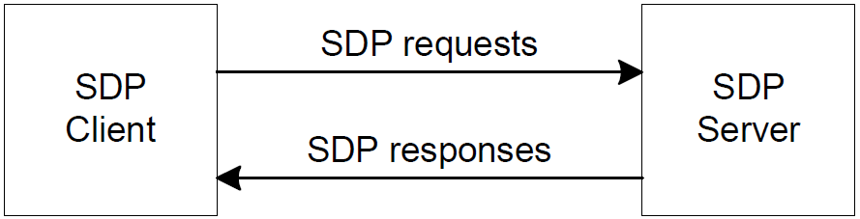
Service Discovery Mechanism
Client discovers the existence of services and the attributes of services [Provided by Server].
Type or Class of service offered.
Mechanism or Protocol information for utilizing the service.
Attributes of
a service
Simplified SDP Client-Server Interaction

Slide 30
Service Discovery Mechanism
Server maintains a list of service records.
Each service record contains information about a single service.
Client retrieve a service record by issuing an SDP request.
Client opens a separate connection to the service provider for utilizing the service.
Client use SDP to poll Server for inferring whether Server is available.
Discover services and their attributes. [Provided]
Utilize those services. [Not Provided]
SDP

Slide 31
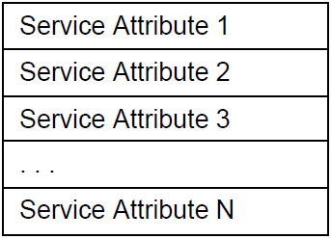
Service Record
Service provides information, performs an action, or controls a resource.
A service record handle is a 32-bit number.
A service record handle identifies each service record within an SDP server uniquely.
Each handle is unique only within each SDP server.
Software
Hardware
Combination of hardware and software
Service

Slide 32
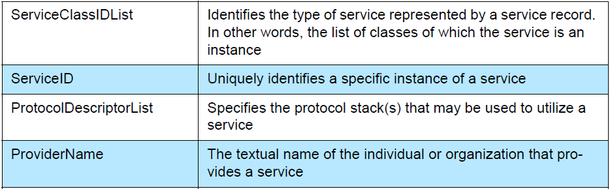
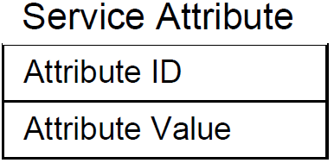
Service Attribute
Describes a single characteristic of a service.
Service providers can define their own service attributes.
Examples of service attributes
Attribute ID
Attribute Value
Service
Attribute

Slide 33
Attribute ID & Attribute Value
16-bit unsigned integer.
Distinguish each service attribute from others within a service record.
Identify the semantics of the associated attribute value.
A service class definition specifies each of the attribute IDs for a service class.
Unique only within each service class.
ID
Variable length field.
Attribute ID and Service class determine meanings.
Value

Slide 34
Service Class
Each service is an instance of a service class.
Service Class Definition provides the definitions of all attributes contained in service records.
Each service class is assigned a unique identifier in ServiceClassIDList attribute.
Service class identifier is represented as a UUID (Universally Unique Identifier).

Slide 35
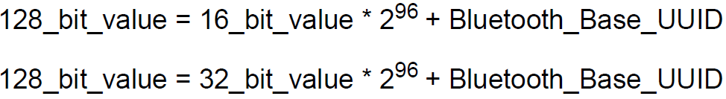
UUID
128-bit value.
Unique across all space and all time.
A range of UUID values has been pre-allocated for registered purposes.
128-bit value of a 16-bit or 32-bit UUID can be computed by a simple arithmetic operation.
Bluetooth Base UUID: 00000000-0000-1000-8000-00805F9B34FB
Service Search Pattern: a list of UUIDs used to locate matching service records.

Slide 36
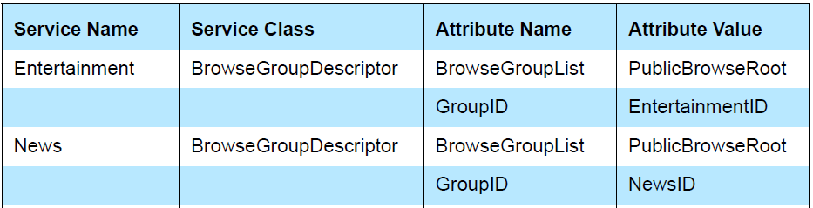
Browsing For Services
A client searches for services based on UUIDs of the services.
Browsing: The process of looking for any offered services.
The mechanism for browsing for services is based on BrowseGroupList attribute.
Example of Service Browsing Hierarchy

Slide 37
Data Representation
Attribute values can contain information of various types with arbitrary complexity.
SDP uses data element to describe the data contained within attribute ID, attribute ID range, and attribute value.
Type descriptor
Size descriptor
Header field
Data field: a sequence of bytes.
Data element
Length: Specified in size descriptor.
Meaning: Specified by type descriptor.
Data field

Slide 38
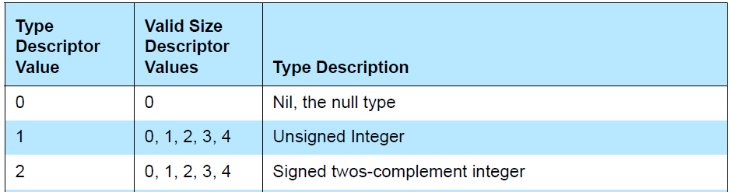
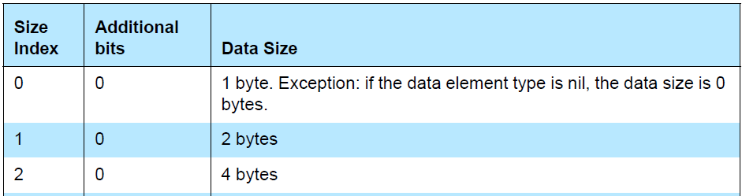
Type Descriptor & Size Descriptor
Type descriptor: Contained in the high-order 5 bits of the first byte of the data element header.
Size descriptor: Contained in the low-order 3 bits of the first byte of the data element header.

Slide 39
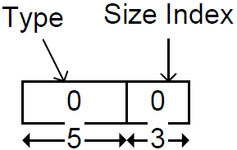
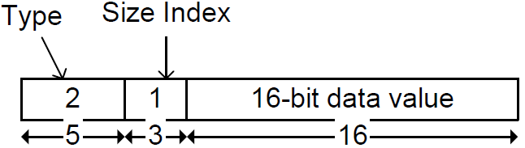
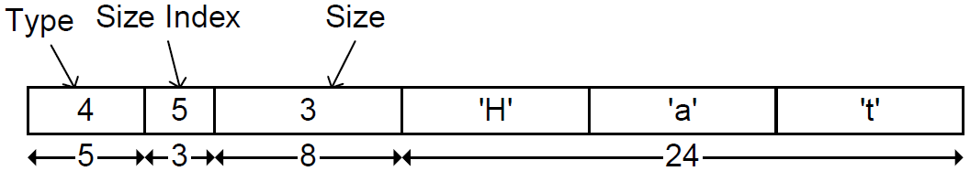
Data Element Example
Nil
16-bit signed integer
3 character ASCII string "Hat"

Slide 40
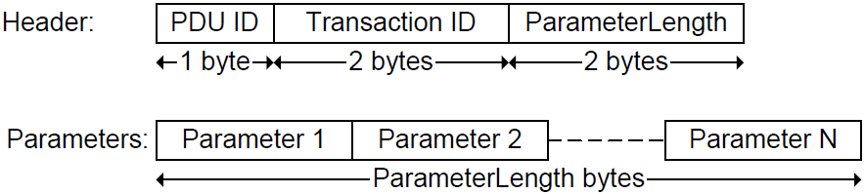
Protocol Description
SDP uses a request/response model.
Each transaction consists of one request protocol data unit (PDU) and one response PDU.
SDP transfers multiple-byte fields in standard network byte order (Big Endian).
PDU ID
Transaction ID
ParameterLength
PDU header
PDU-specific parameters
SDP PDU

Slide 41
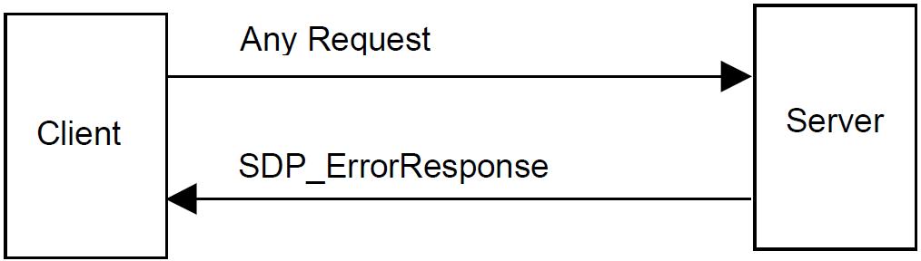
Error Handling
Each type of request PDU has a corresponding type of response PDU.
SDP_ErrorResponse PDU
Server determines that a request is improperly formatted.
Server cannot respond with the appropriate PDU type.

